Slide 1

Final Year Project Evaluation
“Developing a Predictable and Explainable Model for Cardiovascular Diseases”
Department of Computer Science and Engineering
National Institute of Technology, Silchar
Under the Supervision of
Dr. Biswajit Purkayastha
Professor
Prem Babu Kanaparthi(2012040)
Rahul Golla (2012132)
Sai Hemander Kambhampati (2012153)
1

Slide 2
Outline
Tentative Title
Abstract
CHAPTER 1 - Introduction
CHAPTER 2 - Literature Survey 2.1 Research Gap 2.2 Motivation 2.3 Problem Statement 2.4 Objectives
CHAPTER 3 - Dataset Description
CHAPTER 4 - Proposed Methodology
2

Slide 3
Outline
CHAPTER 5 - Experimental Results and Discussions
CHAPTER 6 - Conclusion and Future Work
CHAPTER 7 - References
3

Slide 4
“Developing a Predictable and Explainable Model for
Cardiovascular Diseases”
4

Slide 5
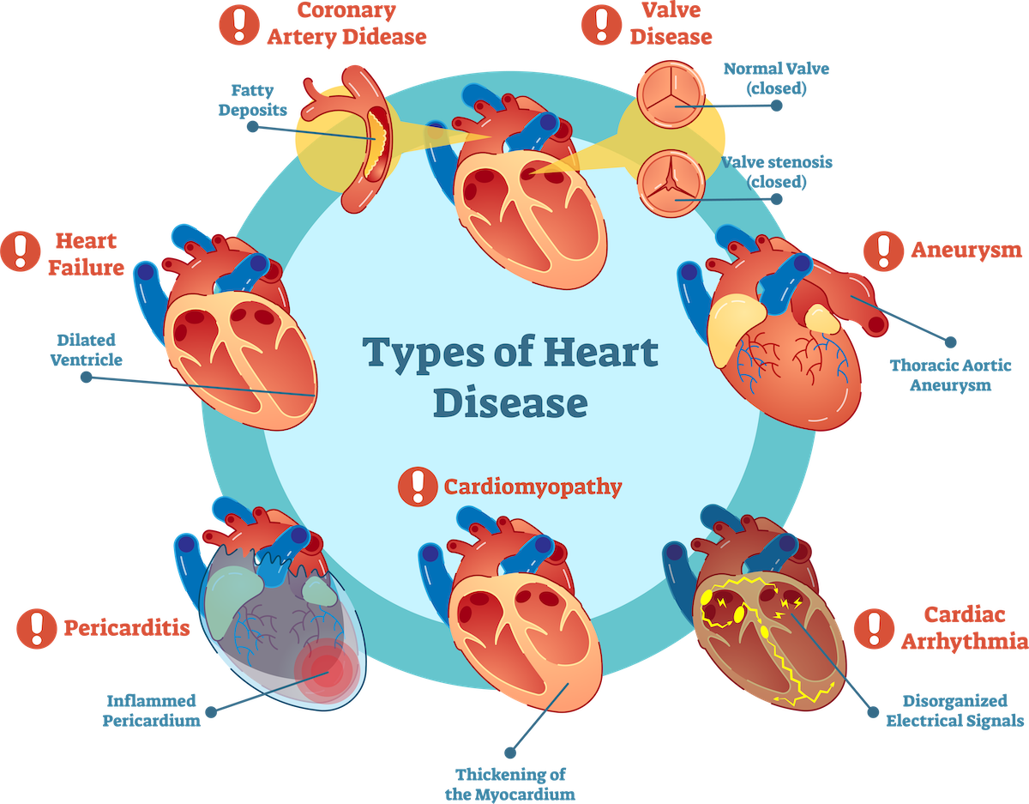
Introduction
Cardiovascular Diseases: Understanding the Silent Killers:
Cardiovascular disease is a group of diseases affecting your heart and blood vessels. These diseases can affect one or many parts of your heart and/or blood vessels.
Types: They include coronary heart disease, cerebrovascular disease, peripheral arterial disease, rheumatic heart disease, congenital heart disease, and deep vein thrombosis and pulmonary embolism.
Causes: The most common cause of heart attacks and strokes is a blockage that prevents blood from flowing to the heart or brain. The most common reason for this is a build-up of fatty deposits on the inner walls of the blood vessels that supply the heart or brain.
Fig 1 :Types of CVDs [1]
5

Slide 6
Introduction(contd)
The Escalation of Cardiovascular Cases Post-COVID-19:
The COVID-19 pandemic has introduced new challenges to global healthcare systems.
While the virus itself posed a significant threat, an unexpected consequence has been the rise in cardiovascular cases.
Studies and reports have indicated a noticeable increase in CVDs after the onset of the pandemic.
The exact causes and mechanisms behind this surge are under investigation.
It is crucial to explore these trends and their implications for public health to develop effective strategies for addressing the post-pandemic cardiovascular challenges.
6

Slide 7
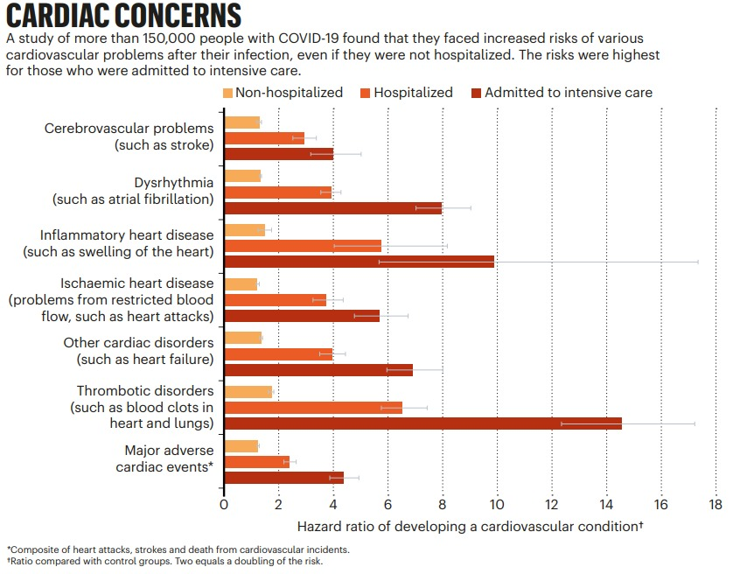
Introduction(contd)
Understanding the Post-COVID Cardiovascular Landscape :
COVID-19 elevates the risk of various cardiovascular problems, especially for those who were hospitalized or in intensive care.
Risk levels correlate with COVID-19 severity - highest for ICU admissions, followed by hospitalization without ICU care, and lower for non-hospitalized cases.
All post-COVID patients are at risk of major adverse cardiac events, with higher risk tied to hospitalization and ICU admission.
Fig 2 : Cardiac Concerns[2]
7

Slide 8
ABSTRACT
This research project focused on three key objectives in medical diagnosis:
Developed an ensemble predictive model using ECG data, achieving 93.11% accuracy for early detection of right ventricle abnormalities.
Constructed a cardiovascular disease model from a dataset of 70,000, integrated with LIME for enhanced explainability, reaching an 88.15% accuracy.
Advanced medical diagnostic predictions by incorporating explainable AI, improving decision-making and efficiency in patient care.
8

Slide 9
Literature Survey
9

Slide 10
Literature Survey
S.NO | Authors & Year | Methods used | Limitations
1 | Yifeng Gao et al.[3] 2023 | CMR Functional, Strain Analysis Deep Learning Model Construction Survival Analysis and Risk Stratification | Include right ventricular analysis to improve accuracy for right-sided heart conditions.
2 | Sherry‑Ann Brown et al.[4] 2023 | Artificial Intelligence Algorithms Rules-Based Algorithm Patient Similarity Machine Learning & Network Analysis | Algorithm Explainability : While the study mentions that the AI algorithms used are explainable, Clinicians and patients need to understand how predictions are made.
3 | Zekai Wang et al.[5] 2023 | MadeGAN Semi-supervised learning Adversarial Training | Single-lead ECG limits cardiac analysis
4 | Karl‑Patrik et al.[6] 2023 | Decision tree Random Forest Feature Analysis | Translating complex predictions into actionable clinical decisions.
10

Slide 11
Literature Survey
S.NO | Authors & year | Methods used | Limitations
5 | Adiba Ibnat Hossainet al.[7] 2023 | Ensemble Voting Classifier Naïve Bayes | The hybrid models developed causing overfitting problems
6 | Abeer Abdul et al.[8] 2023 | D CNN model architecture Pooling Function | There should be a research gap prioritizing prediction for elder patients with critical conditions.
7 | Surjeet Dalal et al.[9] 2023 | Bayesian network Random Forest | Integrating and using extra patient data for predicting and managing heart failure risk.
8 | Niloy Biswas et al.[10] 2023 | Support vector machine KNN capture | The paper does not visualize any correlation between features, which could be an interesting aspect to explore in future research.
11

Slide 12
Literature Survey
S.NO | Authors & year | Methods used | Limitations
9 | Achyut Tiwari et al.[11] 2023 | Extra tree classifer Random Forest XGBoost | No comparison on the real world data
10 | Bhushan et al.[12] 2023 | random forest Transfer learning Convolutional neural network. | Explore various data augmentation techniques Identify required features for the dataset
11 | Mahboobeh et al.[13] 2023 | Convolutional Neural Networks (CNNs) Recurrent Neural Networks (RNNs) | Current technology can detect if someone has a heart issue but can't determine its severity. Exploring additional features for prediction could enhance the model's accuracy.
12 | Bingzheng et al.[14] 2023 | Support Vector Machine Unsupervised Learning | Check effectiveness of proposed method on different ultrasonic image types.
12

Slide 13
Literature Survey
S.NO | Authors & year | Methods used | Limitations
13 | Ahmed Al Ahdal et al.[15] 2023 | Random Forest K-Nearest Neighbors (KNN) Decision Trees | Current technology can detect if someone has a heart issue but can't determine its severity. Exploring additional features for prediction could enhance the model's accuracy.
14 | chintan M bhatt et al.[16] 2023 | Multilayer Perceptron (MP) XGBoost (XGB). | Model's accuracy impact from missing data and outliers not analyzed.
15 | Istiak Mahmud et al.[17] 2023 | Random Forest Classifier Gaussian Naive Bayes | Comparison of these models’ performance. Future work could include a more thorough comparison of different models.
13

Slide 14
Research Gaps
Interpretable Machine Learning in Clinical Decision-making: Addressing the interpretability of machine learning results in translating complex predictions into actionable clinical decisions.
Inclusion of Right Ventricular Deformation: Enhancing predictive accuracy by including right ventricular deformation analysis, especially for conditions affecting the right side of the heart.
Comparison with Other Risk Assessment Tools: Expanding the comparison of Reti-CVD with other established risk assessment tools beyond QRISK3.
Data Quality and Standardization: Developing standardized protocols for CMRI data acquisition and annotation to enhance the reliability of AI models.
14

Slide 15
Research Gaps
Comparison of Models and Ensemble Techniques: Conducting a comprehensive comparison of various deep learning models and ensemble techniques for cardiac disease diagnosis, considering accuracy, interpretability, and generalizability.
Severity of Heart Disease Prediction: Developing models that can predict the severity of heart disease, in addition to detecting its presence.
Feature Engineering: Exploring additional features, such as BMI, blood pressure variability, blood glucose levels, and ECG reports, for improving model performance
Inclusion of Other Risk Factors: Incorporating additional risk factors like lifestyle factors or genetic predispositions into predictive models.
15

Slide 16
Motivation
Cardiovascular diseases are one of the leading cause of deaths worldwide, and early prediction can help prevent adverse outcomes and reduce the burden on healthcare systems. By addressing the research gaps in this field, we can try to develop more accurate, personalized, and timely prediction models, ultimately improving patient outcomes and reducing healthcare costs.
16

Slide 17
Problem Statement
The research targets enhanced precision in cardiovascular disease prediction models, specifically for children and the elderly. By integrating additional features like blood pressure variability, blood glucose levels, and ECG reports, the goal is to boost overall accuracy and effectiveness of predictive models.
Additionally, the complexity of machine learning predictions hampers their integration into clinical decisions. This research seeks to address these limitations by incorporating crucial features, analyzing right ventricular deformation, and employing explainable AI, aiming to improve the effectiveness and interpretability of cardiovascular disease prediction models
17

Slide 18
Objectives
This research aims to develop a high performing predictive model using ECG reports, to enhance predictive accuracy, with a particular focus on children, elder patients.
Contributing towards the right ventricle problem detection for early and initial diagnosis from the ECG reports.
Enhance interpretability in clinical decision-making using explainable AI to bridge the gap between complex machine learning predictions and actionable insights.
18

Slide 19
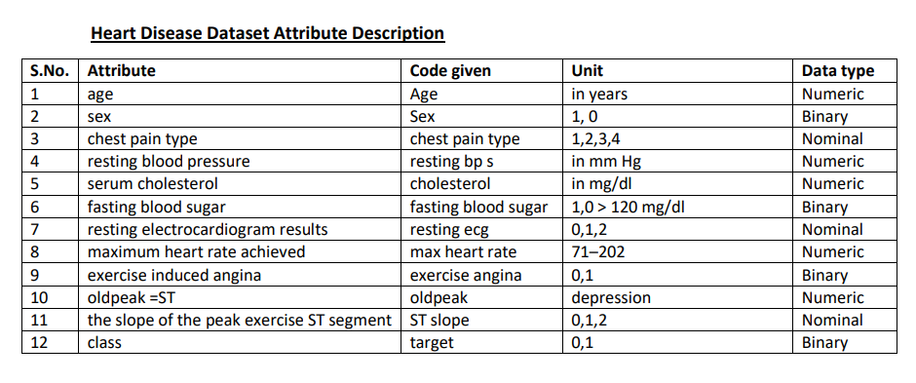
Dataset Description
Objective – 1 & 2:
The dataset includes information on age, sex, chest pain type, resting blood pressure, cholesterol, fasting blood sugar, max heart rate, exercise-induced angina, and old-peak. Subsequently, ECG reports of patients with Right Ventricular Myocardial Infarction were incorporated to enrich the dataset.
The Dataset for Cleveland, Hungary, Switzerland, and Long Beach V, as well as the Heart Statlog Cleveland Hungary Dataset, were employed to assess the performance of predictive models.
19

Slide 20
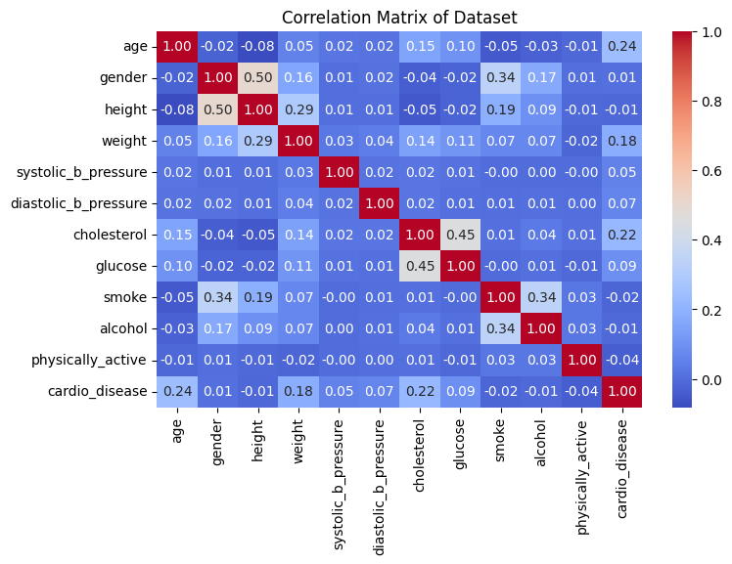
Dataset Description
A) Ensemble Model
Objective - 3:
Dataset Size: 70,000 patient records
Features: 11 features plus a target variable
Feature Types:
Objective: Age, Height, Weight, Gender
Examination: Systolic BP, Diastolic BP, Cholesterol, Glucose
Subjective: Smoking, Alcohol intake, Physical activity
Target Variable: Presence of cardiovascular disease (binary)
Data Collection: All data were gathered during medical
examinations . This dataset facilitates the analysis of potential health indicators related to cardiovascular diseases using objective, examination,
and subjective information from patients.
Fig 3 : Correlation Matrix of Dataset
20

Slide 21
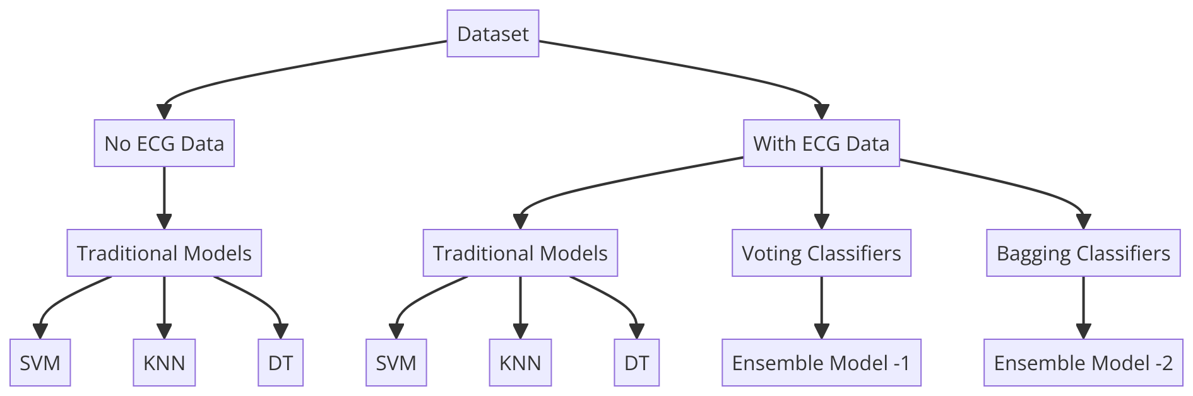
Proposed Methodology
A) Proposed Ensemble Model
(PROPOSED MODEL)
Fig 4 : Ensemble Model Workflow
21

Slide 22
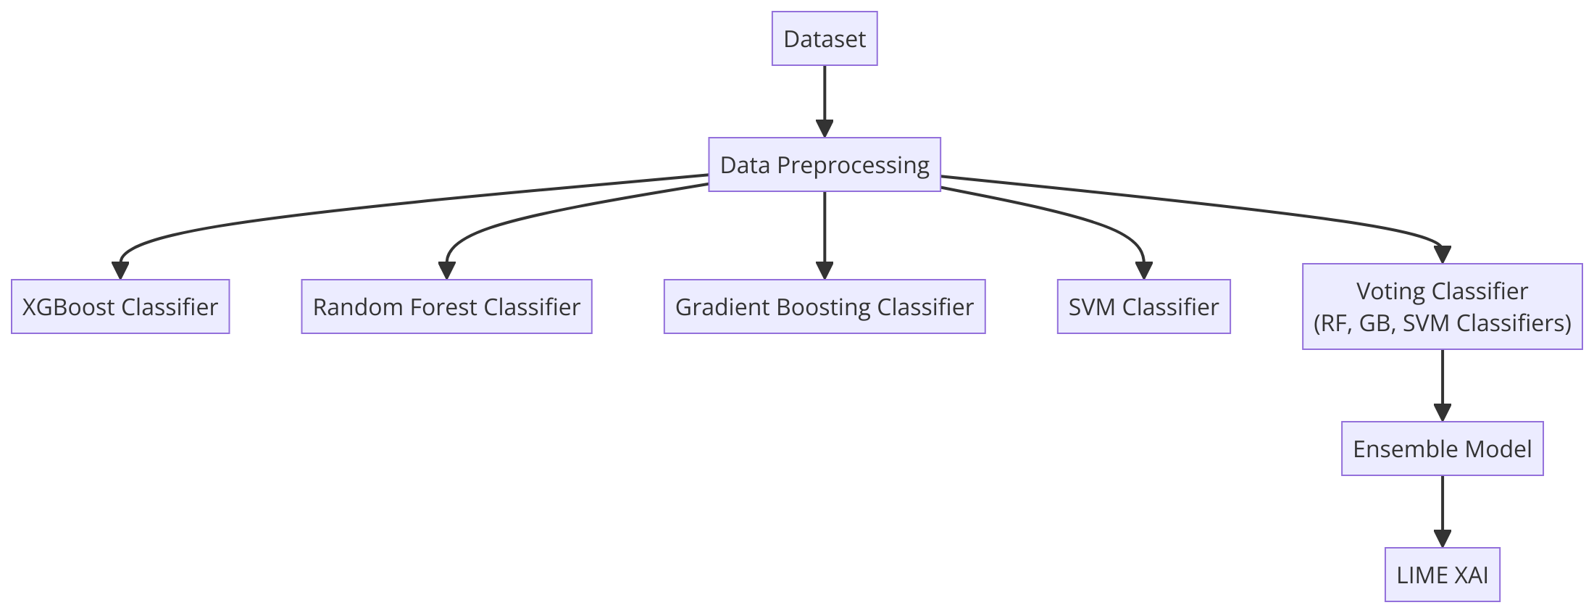
Proposed Methodology
B) Proposed XAI Model:
Fig 5 : XAI Model Workflow
(PROPOSED MODEL)
22

Slide 23
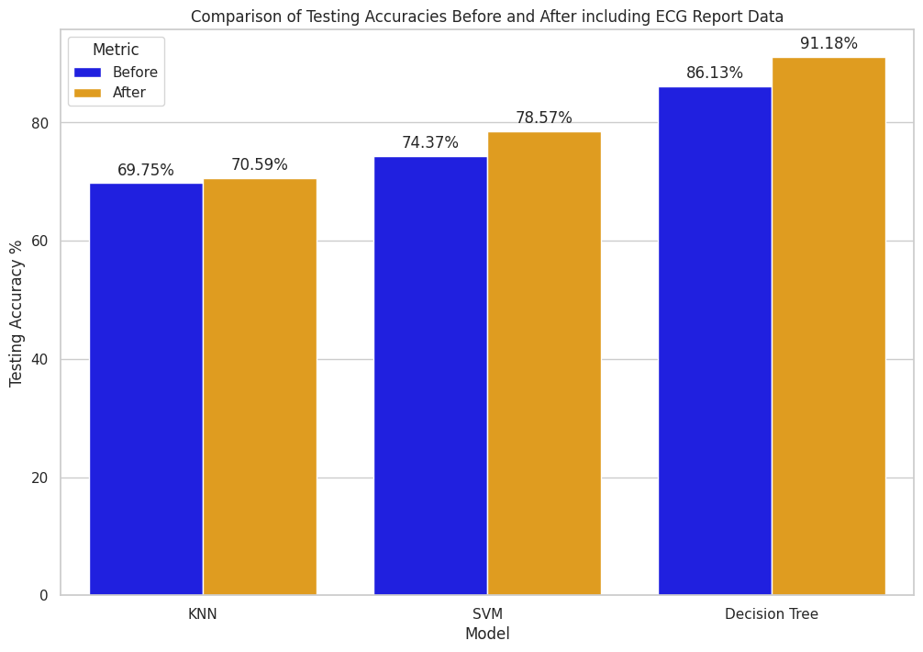
Results and Discussions
A) Ensemble Model:
Before including ECG report data, the testing accuracies of the models were relatively lower as shown. After including ECG report data, there was an increase in the testing accuracies for all three models.
Fig 6 : Comparison of testing accuracies before and after including ECG report data
23

Slide 24
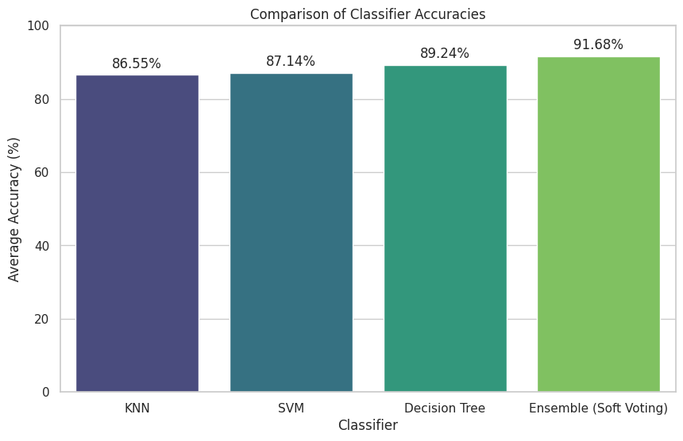
Results and Discussions
Ensembling Phase 1:
Voting Classifier:
Below is a bar graph titled “Comparison of Classifier Accuracies.” It represents the comparison of accuracies of an ensemble voting classifier with other classifiers.
Fig 7 :Ensemble Model-1 Comparison
24

Slide 25
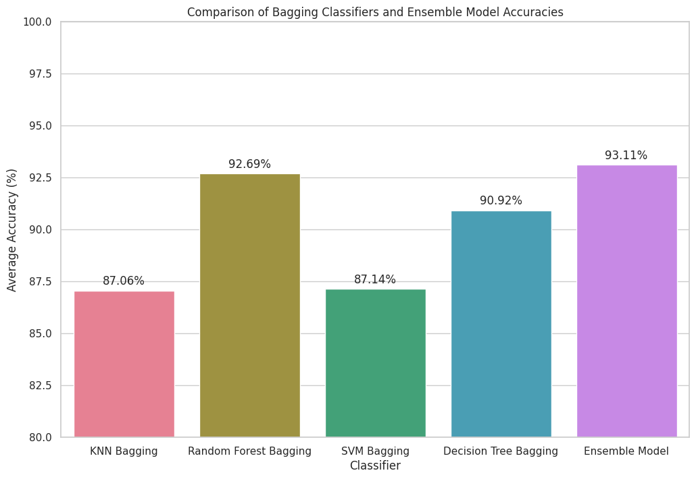
Results and Discussions
Ensembling Phase 2:
The below bar plot presents the comparison between the ensemble model-2 and other classifiers.
Fig 8 : Ensemble Model-2 Comparison
25

Slide 26
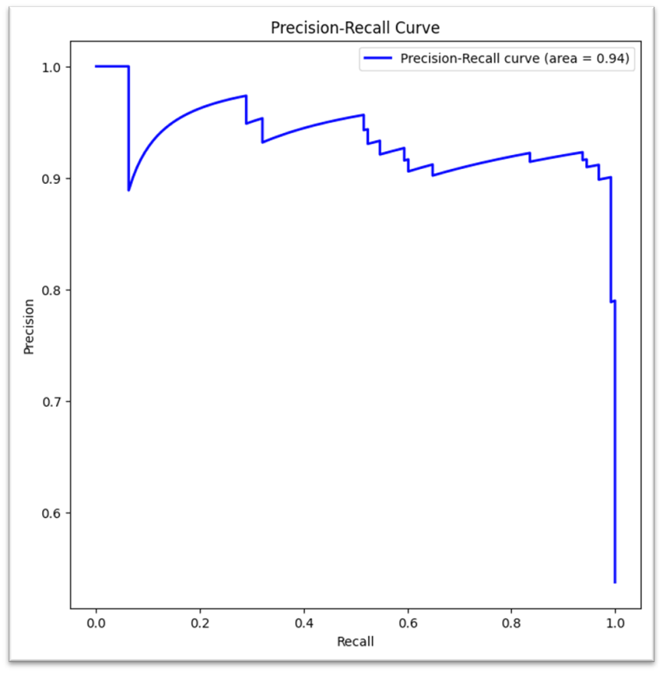
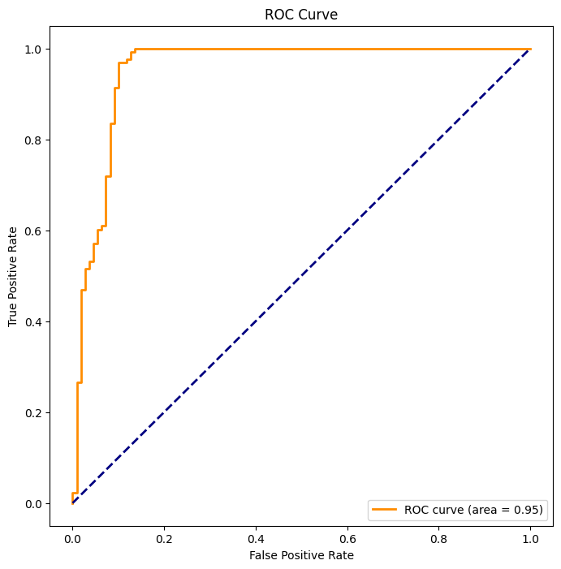
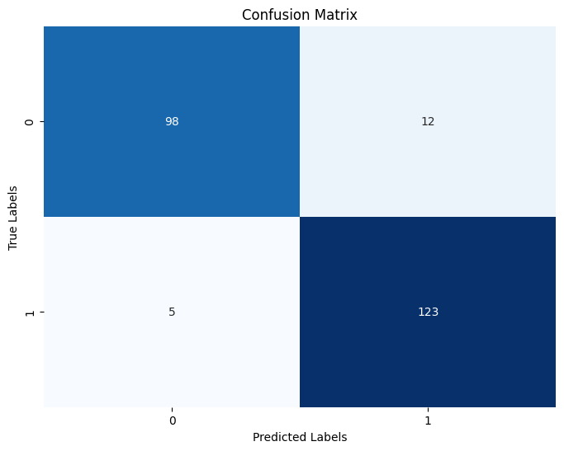
Evaluation metrics of Ensemble Model - 2
Fig 9 : Confusion Matrix
Fig 10 : Precision-Recall Curve
Fig 11 : ROC Curve
26

Slide 27
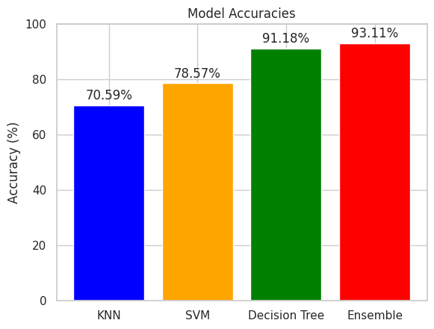
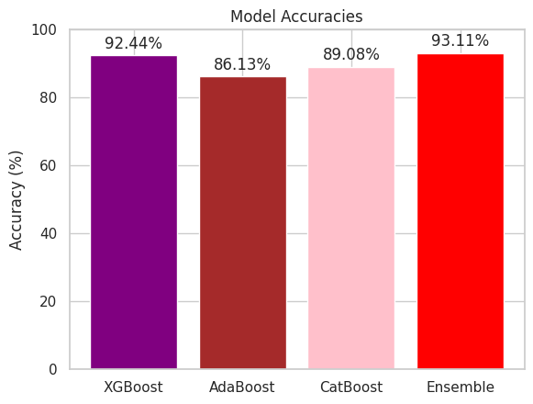
Results and Discussions
Ensemble(proposed) Model Vs Traditional ML Models
Ensemble (proposed) Model Vs Pre-Trained Models
Fig 12 : Proposed Vs Traditional Models
Fig 13 : Proposed Vs Pre-Trained Ensemble Models
27

Slide 28
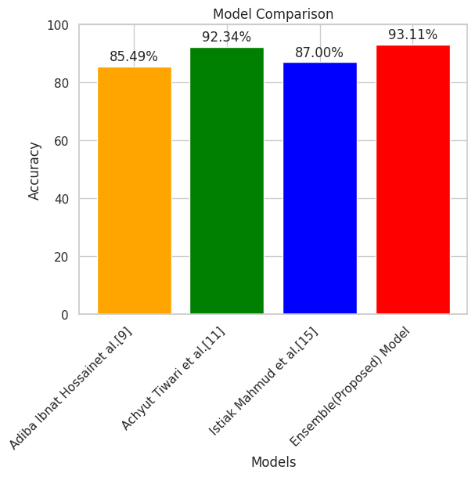
Results and Discussions
Ensemble (proposed) Model Vs Existing Models
Fig 14 : Proposed Vs State of the art Models
28

Slide 29
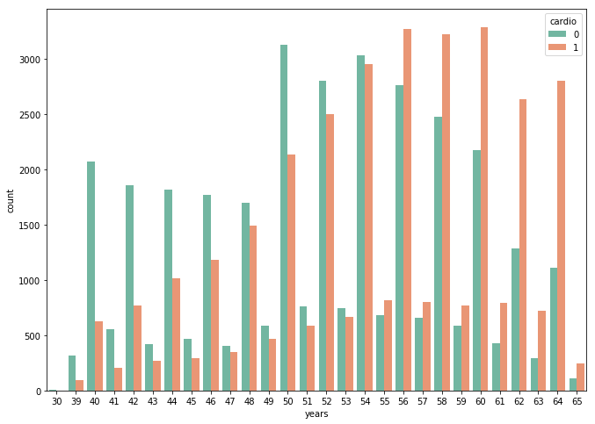
Results and Discussions
B) XAI Model:
The graph shows a clear trend of increasing cardiovascular conditions with age, particularly evident after age 50
Younger age groups (39-49) predominantly display fewer cardiovascular conditions compared to older groups, where the prevalence significantly increases.
The highest prevalence of cardiovascular conditions is observed in the 60-64 age group.
Fig 15 : AGE Vs CVD
29

Slide 30
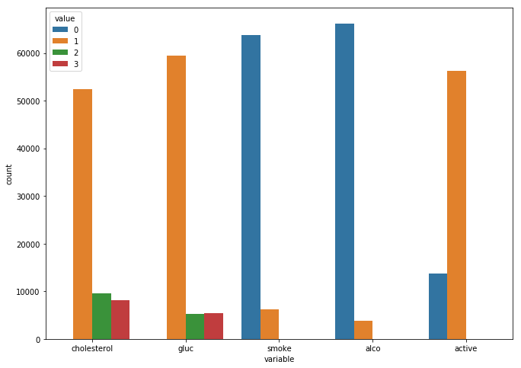
Results and Discussions
Most individuals have normal cholesterol (value 1) and glucose (value 1) levels, do not smoke (value 0), do not consume alcohol (value 0), and are physically active (value 1).
Very few individuals fall into the high-risk categories for cholesterol (value 3) and glucose (value 3), indicating a smaller proportion with severe conditions.
Smoking and alcohol consumption data suggest that the majority are non-smokers and non-drinkers.
Fig 16 : Features Risk Comparison
30

Slide 31
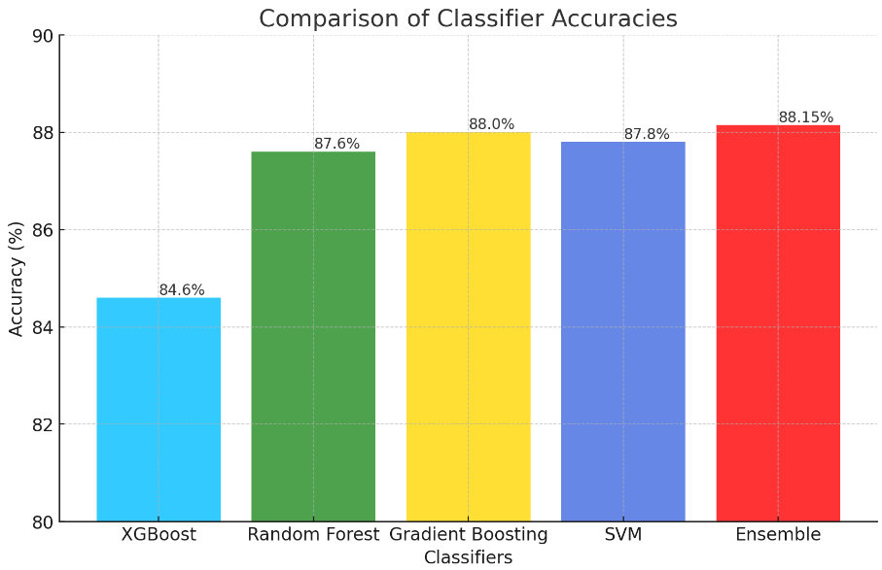
Results and Discussions
The Ensemble classifier shows the highest accuracy at 88.15%, slightly outperforming the other models.
Both the Gradient Boosting and SVM classifiers demonstrate strong performance, with accuracies close to 88%.
XGBoost, while effective, has the lowest accuracy among the classifiers at 84.6%
Fig 17 : Model Accuracies Comparison
31

Slide 32
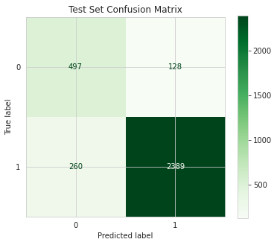
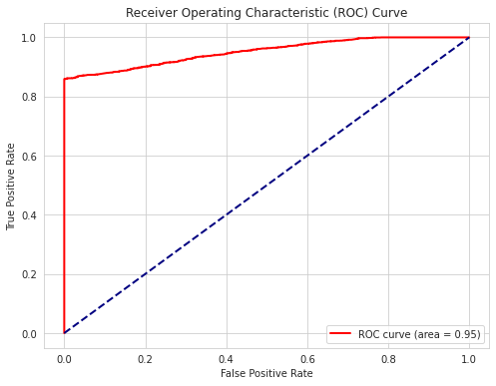
Results and Discussions
Evaluation Metrics of Ensemble Model:
Fig 18 : Ensemble Model Confusion Matrix
Fig 19 : Ensemble Model ROC Curve
32

Slide 33
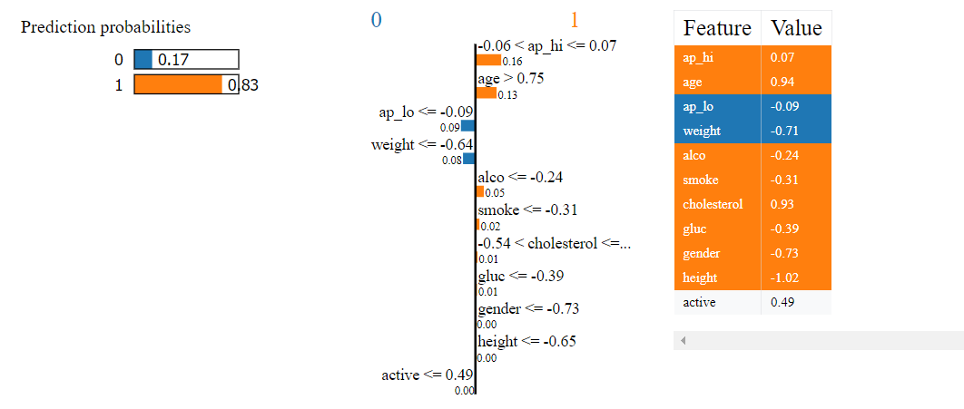
Results and Discussions
Testing on patient data(High Risk of CVD):
Fig 20 : LIME Representation of Patient 1
33

Slide 34
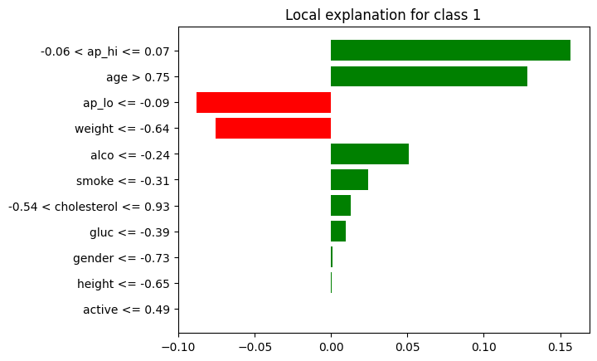
Results and Discussions
Testing on patient data:
The features 'age' and 'cholesterol' contribute significantly to the prediction of Class 1 (CVD presence), indicating that higher values of these attributes strongly suggest the likelihood of having CVD.
‘Weight' and ‘ap_lo' exhibit strong negative impacts on the prediction, indicating that their specific values decrease the likelihood of Class 1
Features such as 'alco', 'smoke', and 'gluc' show smaller positive contributions, implying that their lower values might slightly increase the probability of predicting CVD presence in the model's view.
Fig 21 : Features Impact of Patient 1
34

Slide 35
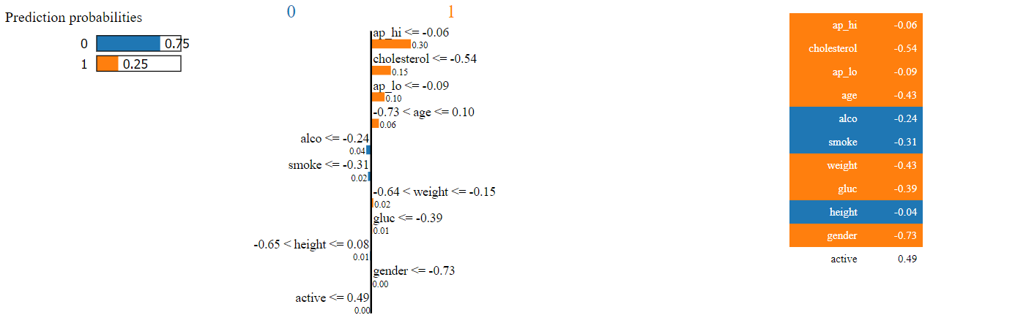
Results and Discussions
Testing on patient data(Low Risk of CVD):
Fig 22 : LIME Representation of Patient 2
35

Slide 36
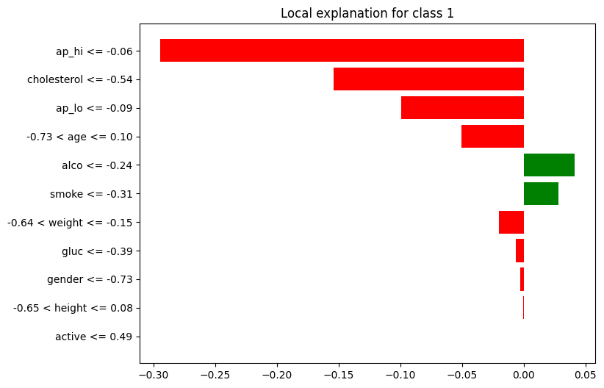
Results and Discussions
Testing on patient data:
The features 'cholesterol', ‘ap_hi display strong negative influences on the prediction of CVD presence, suggesting that certain values of these attributes substantially decrease the likelihood of having CVD.
Several features such as ‘glucose', ‘gender', ‘weight', relatively minor negative impacts, suggesting that their specific values slightly reduce the model's prediction probability of CVD presence.
The features alcohol and smoke make a positive impact in prediction of cvd , suggesting that the patient habits having a little impact on having cvd.
Fig 23 : Features Impact of Patient 2
36

Slide 37
Conclusion and Future work
37

Slide 38
Work Plan and Progress
Activities
Aug-sept
Oct-Nov-Dec
Jan-Feb
March-April-May
Literature survey
Objective - 1
Objective - 2
Objective - 3
44

Slide 39
References
https://www.who.int/news-room/fact-sheets/detail/cardiovascular-diseases-(cvds)
https://www.nature.com/articles/d41586-022-02074-3
Gao, Yifeng, et al. "Deep learning-based prognostic model using non-enhanced cardiac cine MRI for outcome prediction in patients with heart failure." European Radiology (2023): 1-11.
Brown, Sherry-Ann, et al. "Patient similarity and other artificial intelligence machine learning algorithms in clinical decision aid for shared decision-making in the Prevention of Cardiovascular Toxicity (PACT): A feasibility trial design." Cardio-Oncology 9.1 (2023): 7.
Wang, Zekai, Stavros Stavrakis, and Bing Yao. "Hierarchical deep learning with Generative Adversarial Network for automatic cardiac diagnosis from ECG signals." Computers in Biology and Medicine 155 (2023): 106641.
Kresoja, Karl-Patrik, et al. "A cardiologist’s guide to machine learning in cardiovascular disease prognosis prediction." Basic research in cardiology 118.1 (2023): 10.
Hossain, Adiba Ibnat, et al. "Applying machine learning classifiers on ECG dataset for predicting heart disease." 2021 International Conference on Automation, Control and Mechatronics for Industry 4.0 (ACMI). IEEE, 2021.AlArfaj, Abeer Abdulaziz, and Hanan Ahmed Hosni Mahmoud. "Deep Learning Prediction Model for Heart Disease for Elderly Patients." Intelligent Automation and Soft Computing 35.2 (2023): 2527-2540.Hfhch
Dalal, Surjeet, et al. "Application of Machine Learning for Cardiovascular Disease Risk Prediction." Computational Intelligence and Neuroscience 2023 (2023).
Biswas, Niloy, et al. "Machine Learning-Based Model to Predict Heart Disease in Early Stage Employing Different Feature Selection Techniques." BioMed Research International 2023 (2023).
38

Slide 40
References
Ospina, Raydonal, et al. "On the Use of Machine Learning Techniques and Non-Invasive Indicators for Classifying and Predicting Cardiac Disorders." Biomedicines 11.10 (2023): 2604.
Tiwari, Achyut, Aryan Chugh, and Aman Sharma. "Ensemble framework for cardiovascular disease prediction." Computers in Biology and Medicine 146 (2022): 105624.Jafari, Mahboobeh, et al. "Automated diagnosis of cardiovascular diseases from cardiac magnetic resonance imaging using deep learning models: A review." Computers in Biology and Medicine (2023): 106998.
Wu, Bingzheng, et al. "An Effective Machine-Learning Based Feature Extraction/Recognition Model for Fetal Heart Defect Detection from 2D Ultrasonic Imageries." CMES-Computer Modeling in Engineering & Sciences 134.2 (2023).
Al Ahdal, Ahmed, et al. "Monitoring Cardiovascular Problems in Heart Patients Using Machine Learning." Journal of Healthcare Engineering 2023 (2023).
Bhatt, Chintan M., et al. "Effective heart disease prediction using machine learning techniques." Algorithms 16.2 (2023): 88.
Cyriac, S., R., S. & Raju, N. (2022). Cardiovascular Disease Prediction through Ensembled Transfer Learning on Cardiac Magnetic Resonance Imaging. Journal of Computer Science, 18(11), 1005-1020.
Ng, Frederick & Jiang, Ruihan & Chow, James. (2020). Predicting radiation treatment planning evaluation parameter using artificial intelligence and machine learning. IOP SciNotes. 1. 014003. 10.1088/2633-1357/ab805d.
Mahmud, Istiak, et al. "Cardiac Failure Forecasting Based on Clinical Data Using a Lightweight Machine Learning Metamodel." Diagnostics 13.15 (2023): 2540.
https://www.cardiacatlas.org/amrg-cardiac-atlas/
39

Slide 41
THANK YOU!
40

